Slide 1
Explaining
Voluntary Carbon Market in 10 Minutes
By Sean Huang
View Power BI dashboard
View GitHub

Slide 2
Content

Slide 3
Overview
What is the voluntary carbon market?
There are many ways to reduce carbon emissions or remove carbon from the atmosphere. All of which, however, require funding. Voluntary carbon market directs funds from companies interested in solving climate change to projects that reduce/remove carbon.
How does the voluntary carbon market work?
Project developers reduce/remove carbon.
Carbon standards issue and track carbon credits after they are verified.
Buyers purchase carbon credits and fund project developers in doing so.
How is this project useful?
The voluntary carbon market has been debated for years, particularly over its role in climate change mitigation. Some see carbon credits as an essential tool for addressing hard-to-abate emissions, while others worry that they may distract from meaningful decarbonization efforts.
Yet during my thesis research, I found a more fundamental challenge: Understanding the voluntary carbon market itself is surprisingly difficult. The market is complex and fragmented, with multiple carbon standards, project types, certification schemes, and overlapping terminology.
By analyzing and visualizing publicly available data and combining them with my thesis findings, this project aims to make the voluntary carbon market more accessible and help readers understand its current state and possible future development in 10 minutes.

Slide 4
Method
Qualitative: MSc thesis research
21 expert interviews (9 NGOs, 8 businesses, 3 states, 1 researcher) and policy research from my MSc thesis (https://studenttheses.uu.nl/handle/20.500.12932/52522).
Quantitative: exploring carbon project data
Cleaning, transforming, and analyzing data on 11,000 carbon projects to visualize market trends and insights using Python and Power BI.
Data source:
Pamela Quartson, Barbara K Haya, Tyler Bernard, Aline Abayo, Xinyun Rong, Ivy S So, Micah Elias. (2026). Voluntary Registry Offsets Database v2026-08, Berkeley Carbon Trading Project, University of California, Berkeley. Retrieved from: https://gspp.berkeley.edu/berkeley-carbon-trading-project/offsets-database.
The current scope of this analysis is projects that issued or retired credits between Jan 2016 and Aug 2026, verified by one of the four major carbon standards (Verra, Gold Standard, ACR, CAR). There are other carbon standards, but these four already account for ~89% of the transaction volume in 2024 (https://www.ecosystemmarketplace.com/publications/2025-state-of-the-voluntary-carbon-market-sovcm/).

Slide 5
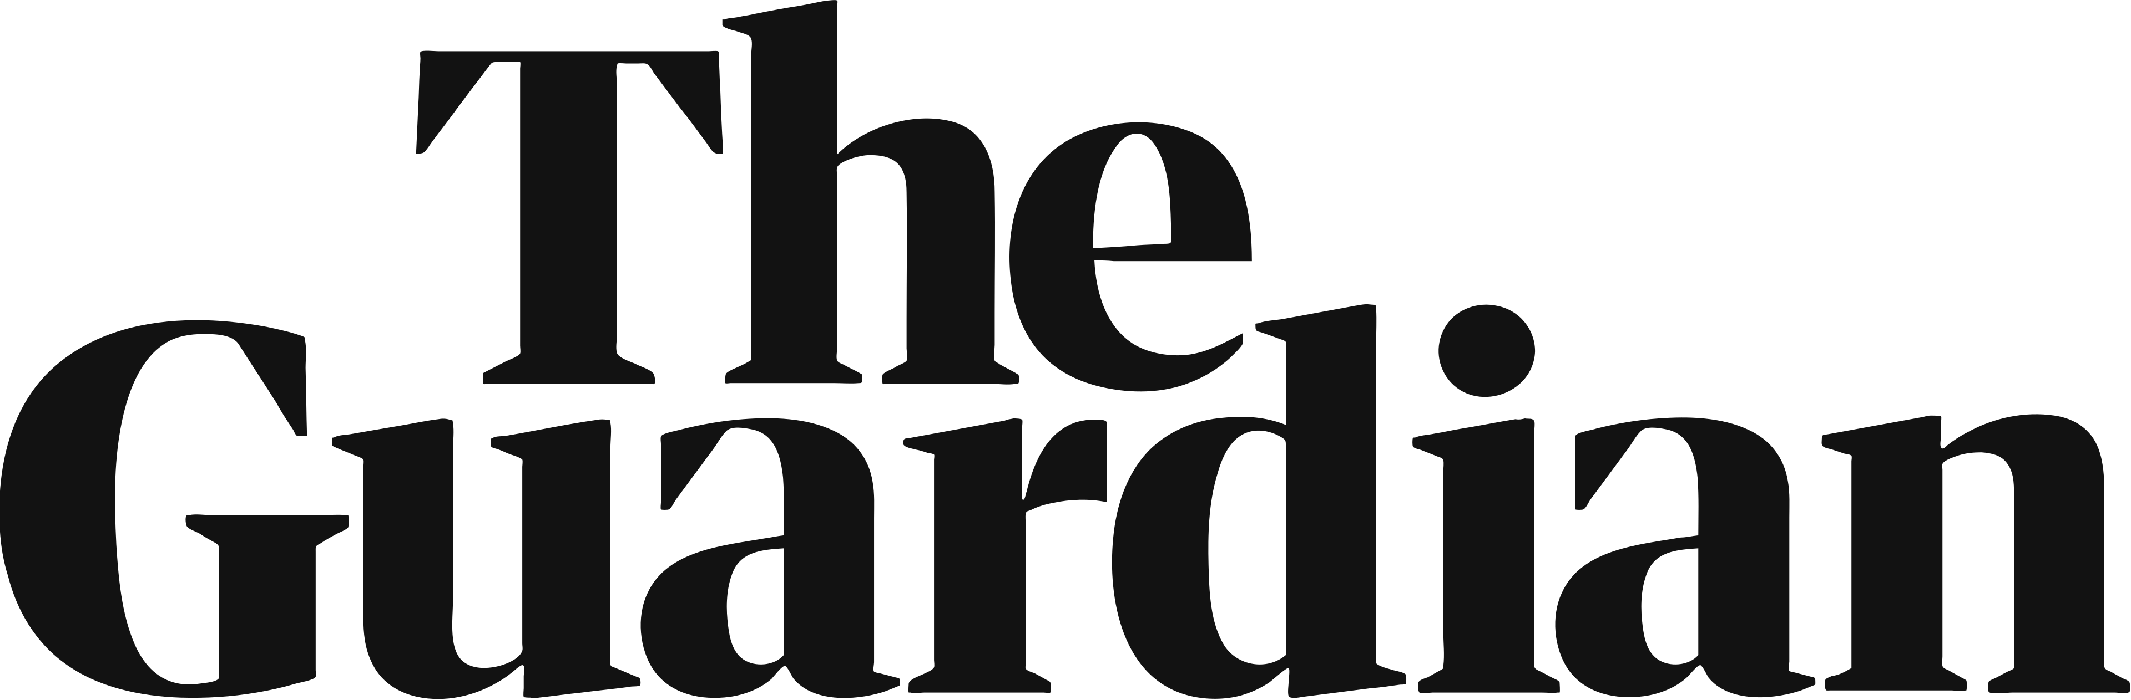
The legitimacy challenge
“Revealed: more than 90% of rainforest carbon offsets by biggest certifier are worthless, analysis shows”¹
What types of projects are accused?
One of the most issued, REDD+ (Reducing Emissions from Deforestation and Forest Degradation).
What are they accused of?
Over-crediting: Issuing more credits than reduced.
Providing no co-benefits for local communities as promised.
What are the consequences?
Buyer hesitation toward certain project types, or even the carbon market as a whole.
“All of a sudden everyone just wants reforestation projects and no one's talking about REDD+ anymore…”
(Business Supplier and Intermediary 1)
Business supplier and intermediary 1
all of a sudden everyone just wants reforestation projects and no one's talking about REDD+ anymore…No one's interested…I think a lot of companies realize that if they want to stay out of trouble, stay out of reputational risk, they need to make sure that the projects are waterproof…there's a more a larger demand to high quality projects nowadays,

